Slide 1
Implementing and Evaluating MPTCP on the SCION Future Internet Architecture
Presentation master thesis
Michael A. Flückiger
August 28, 2020

Slide 2
Projektanalyse – Folie 2
On the menu
Introduction
Functionality of Shila
Performance evaluation
Future work
Notes:
Introduction: What ingredients? What? Why?
Shila: How? (Setup – Connection establishment – Data transfer)
Performance: How good?
Future work: What is next?

Slide 3
Projektanalyse – Folie 2
On the menu
Introduction
Functionality of Shila
Performance evaluation
Future work
Notes:
Introduction: What ingredients? What? Why?
Shila: How? (Setup – Connection establishment – Data transfer)
Performance: How good?
Future work: What is next?

Slide 4
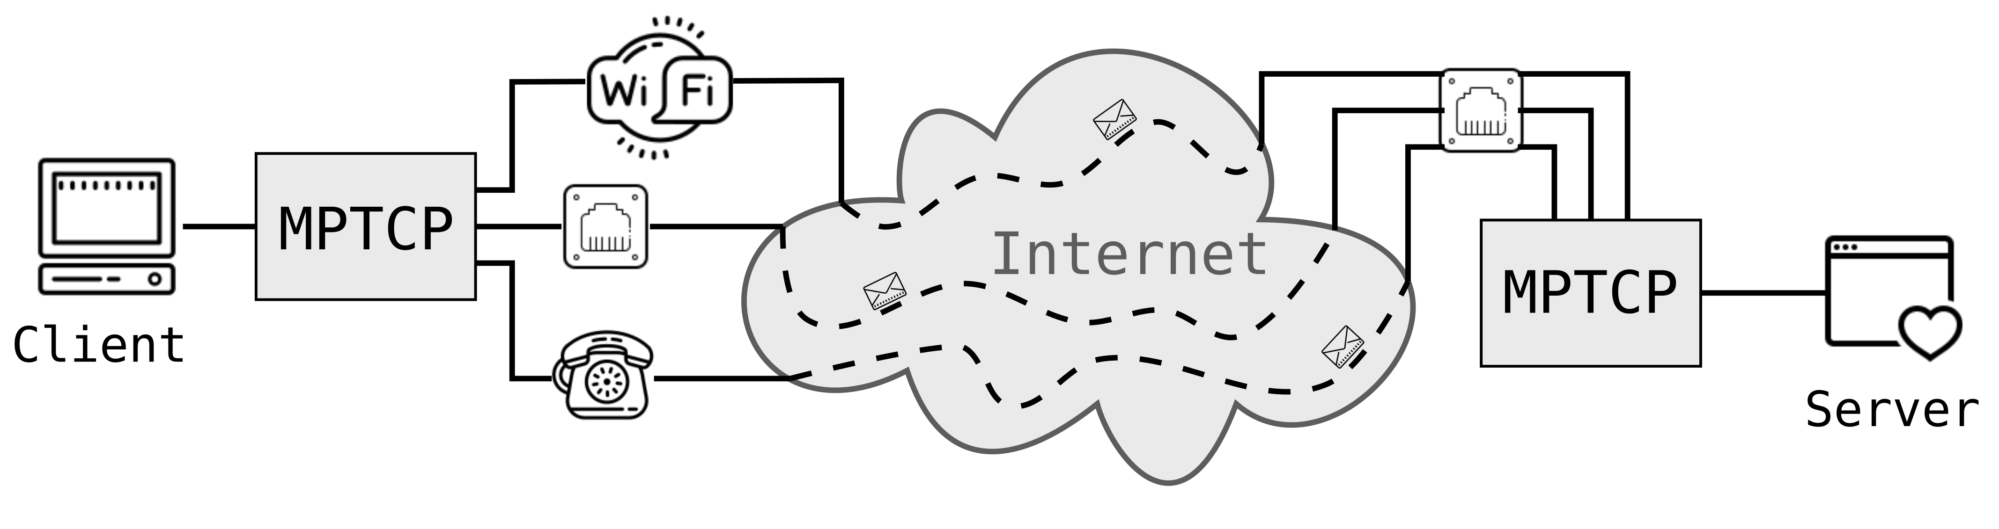
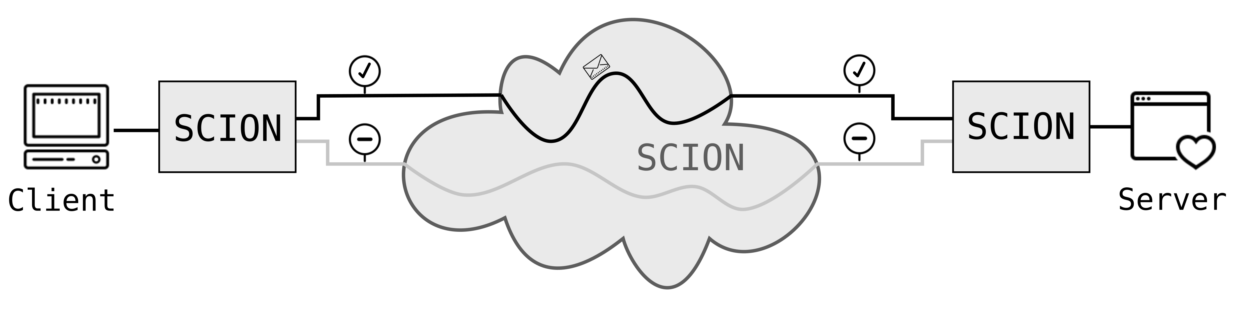
Projektanalyse – Folie 2
Introduction
Ingredients?
TCP (Transmission Control Protocol)
Dominant transport protocol in today’s Internet
One path per connection
MPTCP (Multipath TCP)
Extension to TCP
Multiple paths (flows) per connection
SCION (Scalability, Control and Isolation on next-generation networks)
More secure network architecture
Implements path transparency
Support for multiple paths
Notes:
MPTCP: Usage of all available network interfaces
SCION: Successor of today’s Internet (hopefully ☺)

Slide 5
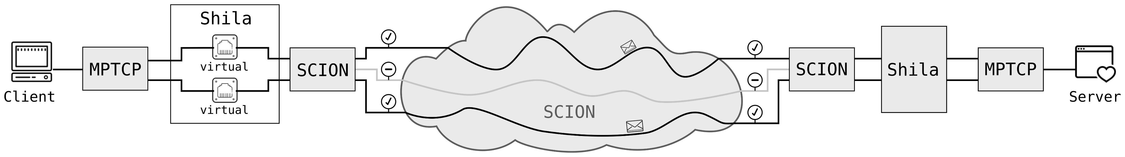
Projektanalyse – Folie 2
Introduction
What?
Main objective and contribution of the presented work:
Implementation (and evaluation) of a shim layer that
allows the usage of MPTCP over SCION.
Notes:
Introduction to Shila. We name our implementation of the shim layer „Shila“

Slide 6



Projektanalyse – Folie 2
Introduction
Why?
Facilitates promotion and development of SCION
Straightforward use TCP applications over SCION
Benefit for endpoints with MPTCP support
Increase of redundancy thanks to multiple paths
Potential through mediating role of Shila in between
Shila is aware and under control of paths used through SCION
Notes:
Easy to use, no changes necessary, user can use his favorite TCP application without having to change alot
Connection with MPTCP over SCION benefits from multiple paths (redundancy) even if there is just one real interface available (at least from path redundance, not from connection redudancy)
Could for example be used to use less consevative congestion contol, w.r.t fairness

Slide 7
Projektanalyse – Folie 2
On the menu
Introduction
Functionality of Shila
Performance evaluation
Future work
Notes:
Introduction: What ingredients? What? Why?
Shila: How? (Setup – Connection establishment – Data transfer)
Performance: How good?
Future work: What is next?

Slide 8

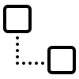
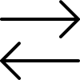
Projektanalyse – Folie 2
Functionality of Shila
Three Parts
Setup
Getting Shila ready to mediate between MPTCP and SCION
Connection establishment
Establish the connection between client and server of a TCP application
Main-Flow and Sub-Flows
Data exchange
Operational mode once connection is up
Notes:
Want to illustrate this three parts based on an running example..

Slide 9
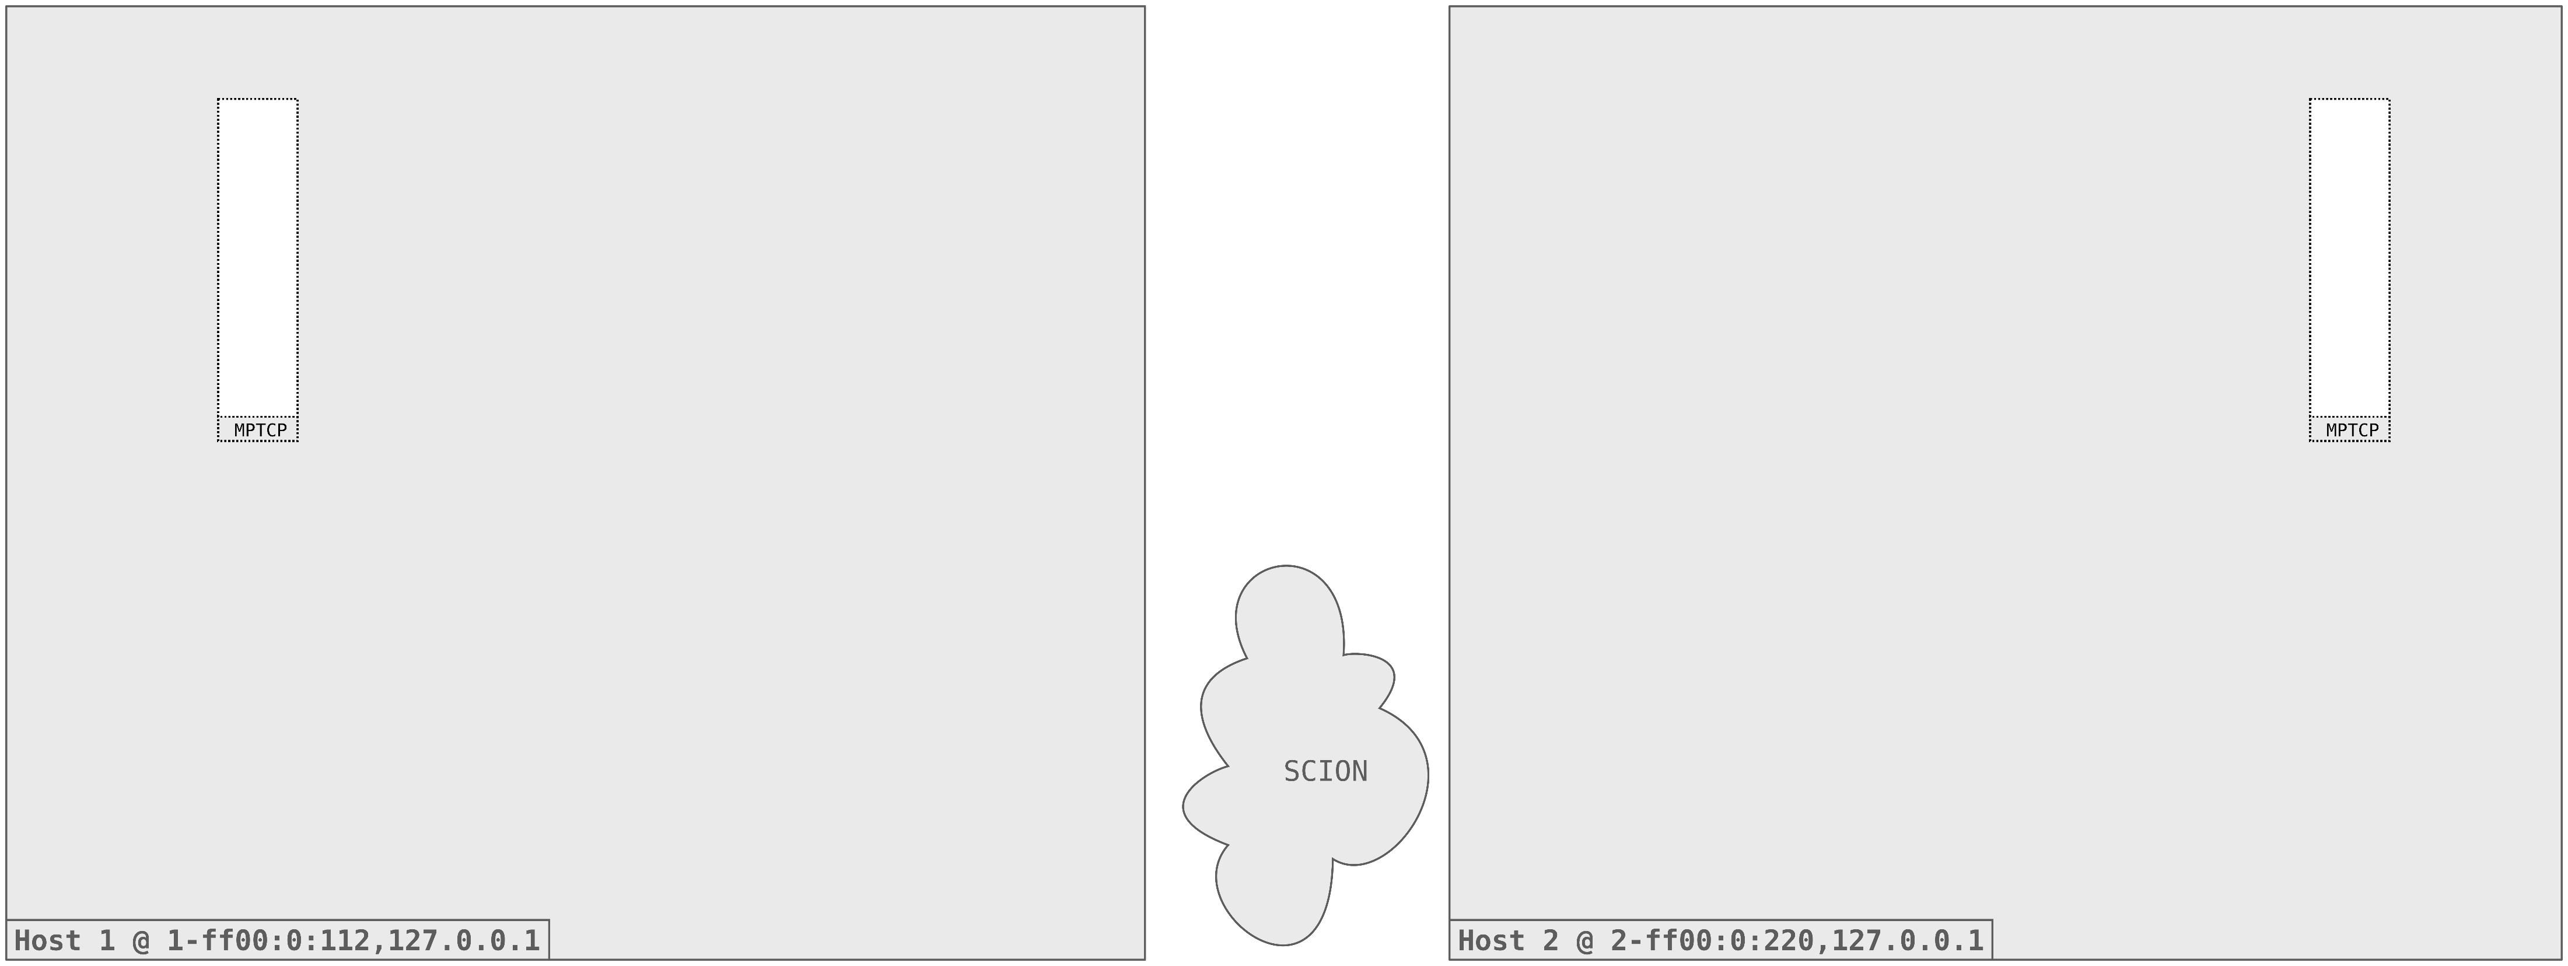
Projektanalyse – Folie 2
Functionality of Shila
Initial situation

Slide 10
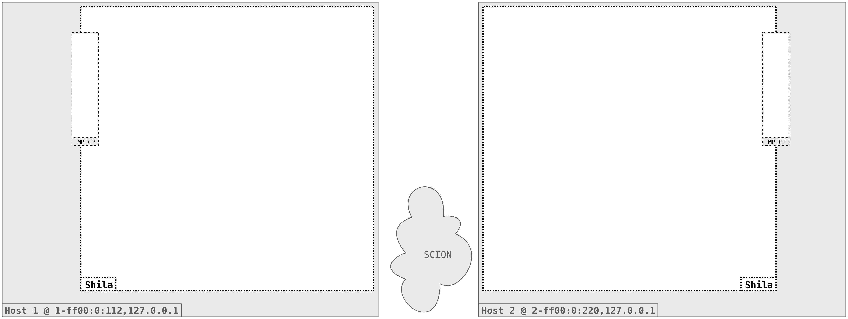
Projektanalyse – Folie 2
Functionality of Shila
Setup

Slide 11
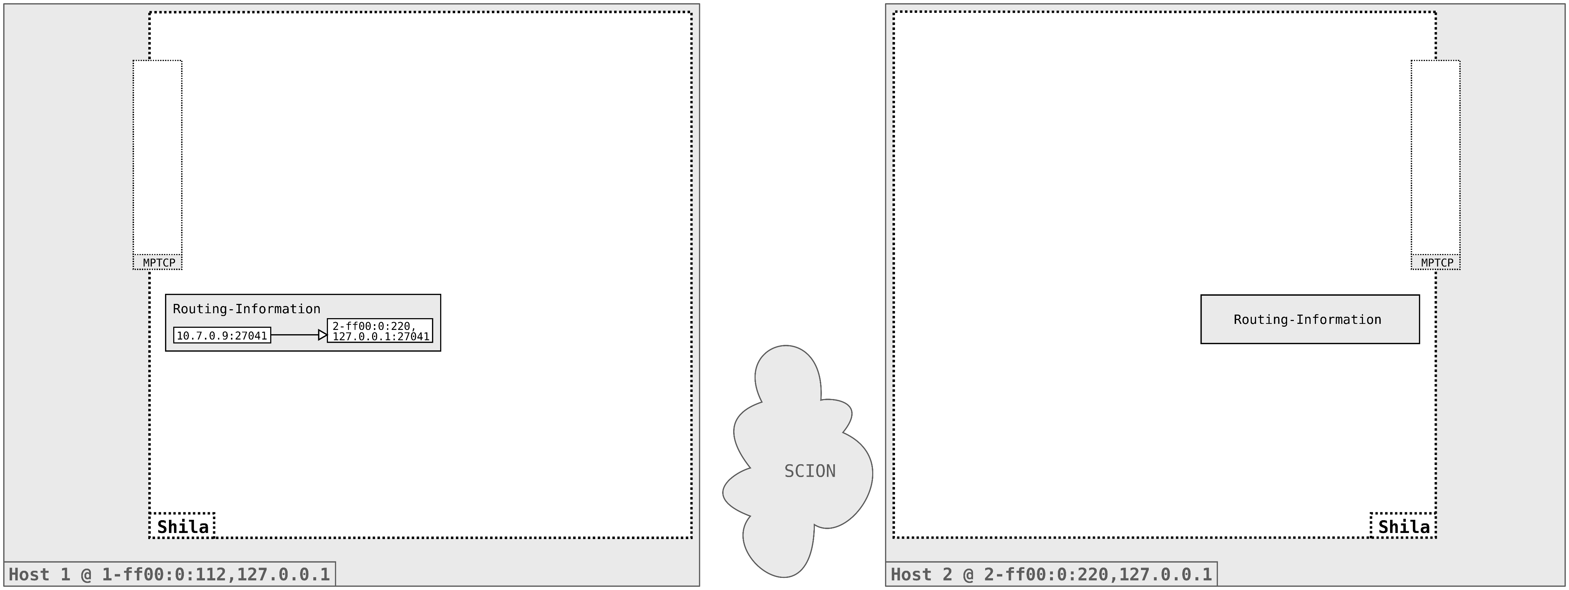
Projektanalyse – Folie 2
Functionality of Shila
Setup

Slide 12
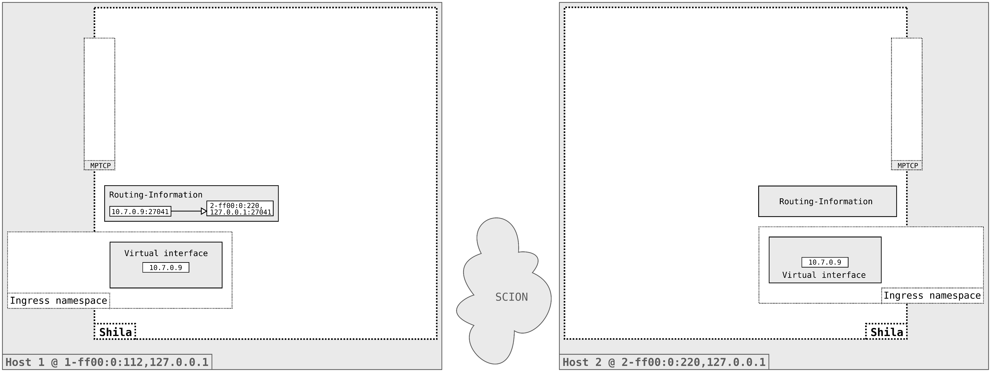
Projektanalyse – Folie 2
Functionality of Shila
Setup

Slide 13
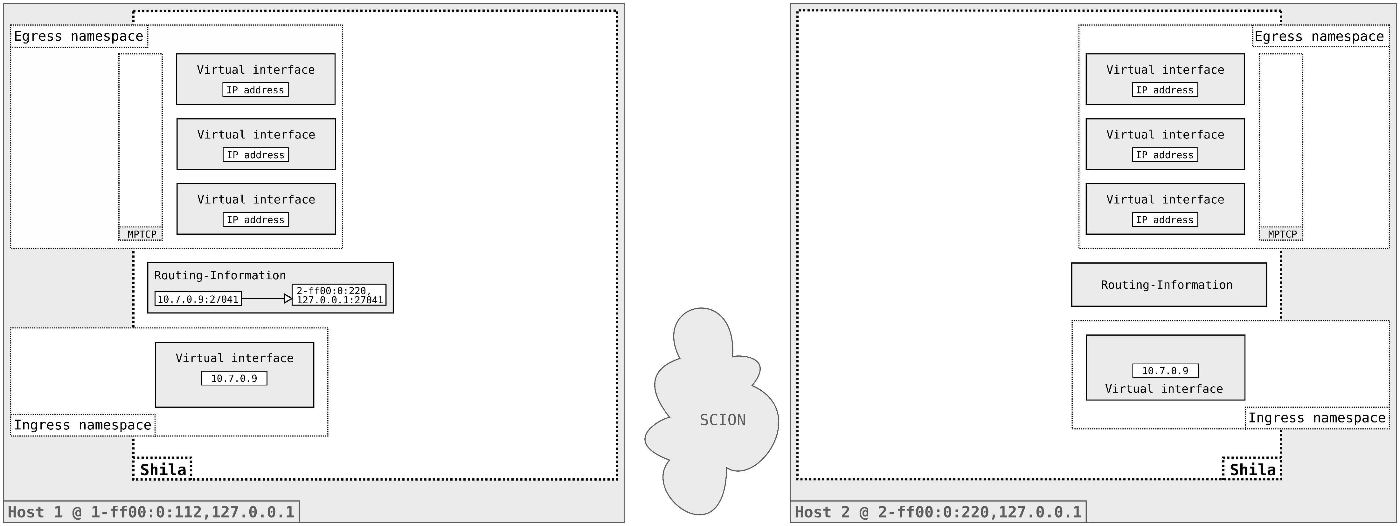
Projektanalyse – Folie 2
Functionality of Shila
Setup

Slide 14

Projektanalyse – Folie 2
Functionality of Shila
Setup

Slide 15
Projektanalyse – Folie 2
Functionality of Shila
Main-Flow Establishment

Slide 16
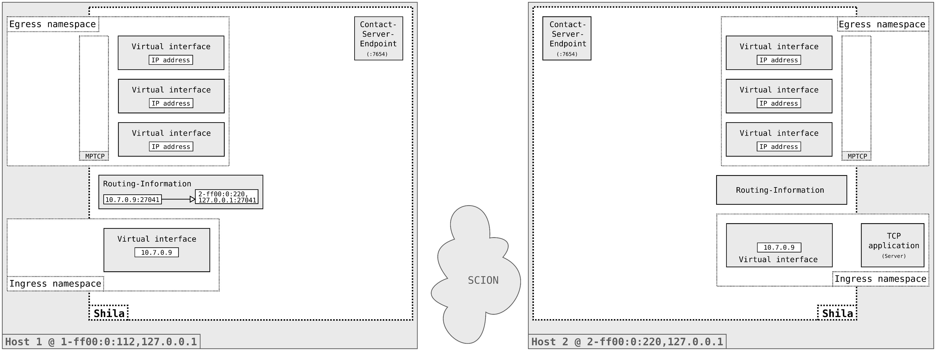
Projektanalyse – Folie 2
Functionality of Shila
Main-Flow Establishment

Slide 17

Projektanalyse – Folie 2
Functionality of Shila
Main-Flow Establishment

Slide 18
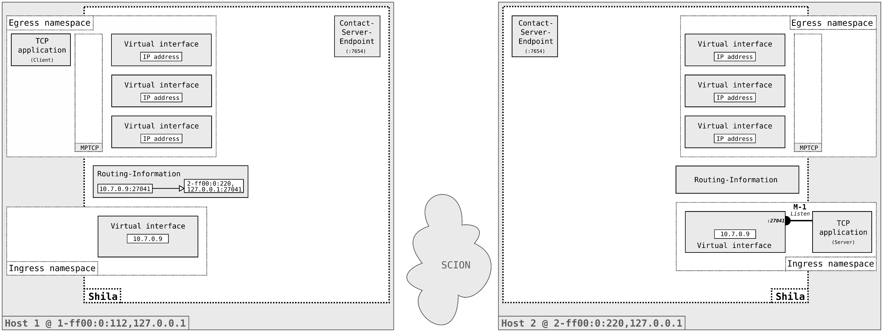
Projektanalyse – Folie 2
Functionality of Shila
Main-Flow Establishment

Slide 19

Projektanalyse – Folie 2
Functionality of Shila
Main-Flow Establishment

Slide 20
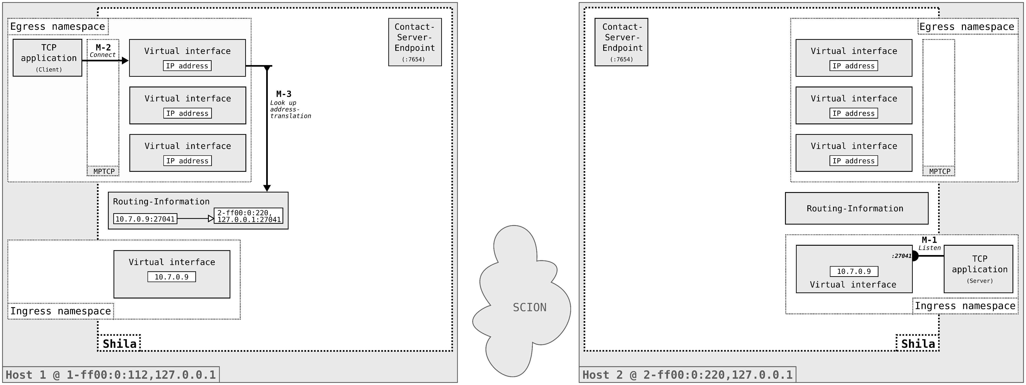
Projektanalyse – Folie 2
Functionality of Shila
Main-Flow Establishment

Slide 21
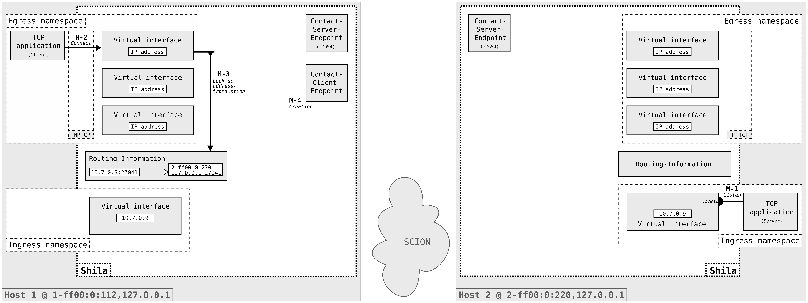
Projektanalyse – Folie 2
Functionality of Shila
Main-Flow Establishment

Slide 22

Projektanalyse – Folie 2
Functionality of Shila
Main-Flow Establishment

Slide 23

Projektanalyse – Folie 2
Functionality of Shila
Main-Flow Establishment

Slide 24

Projektanalyse – Folie 2
Functionality of Shila
Main-Flow Establishment

Slide 25

Projektanalyse – Folie 2
Functionality of Shila
Main-Flow Establishment

Slide 26
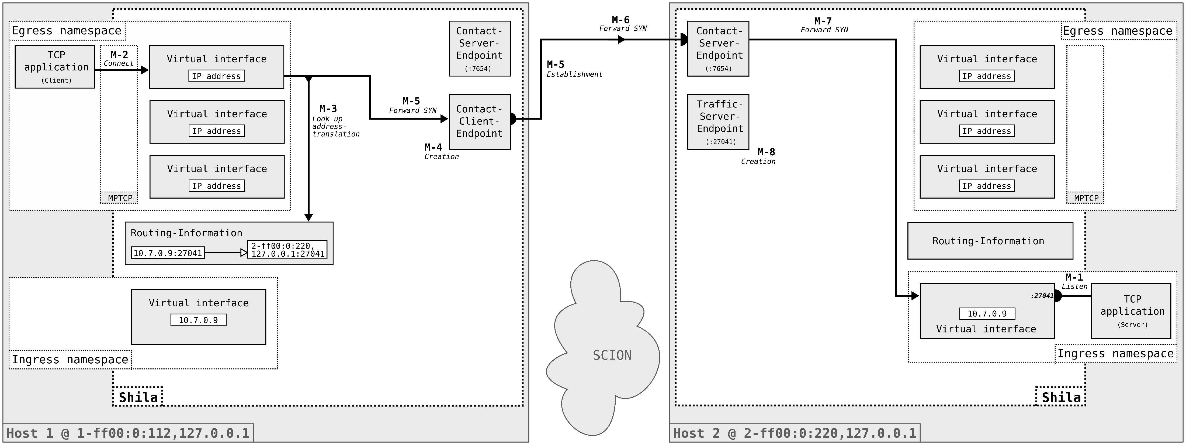
Projektanalyse – Folie 2
Functionality of Shila
Main-Flow Establishment

Slide 27
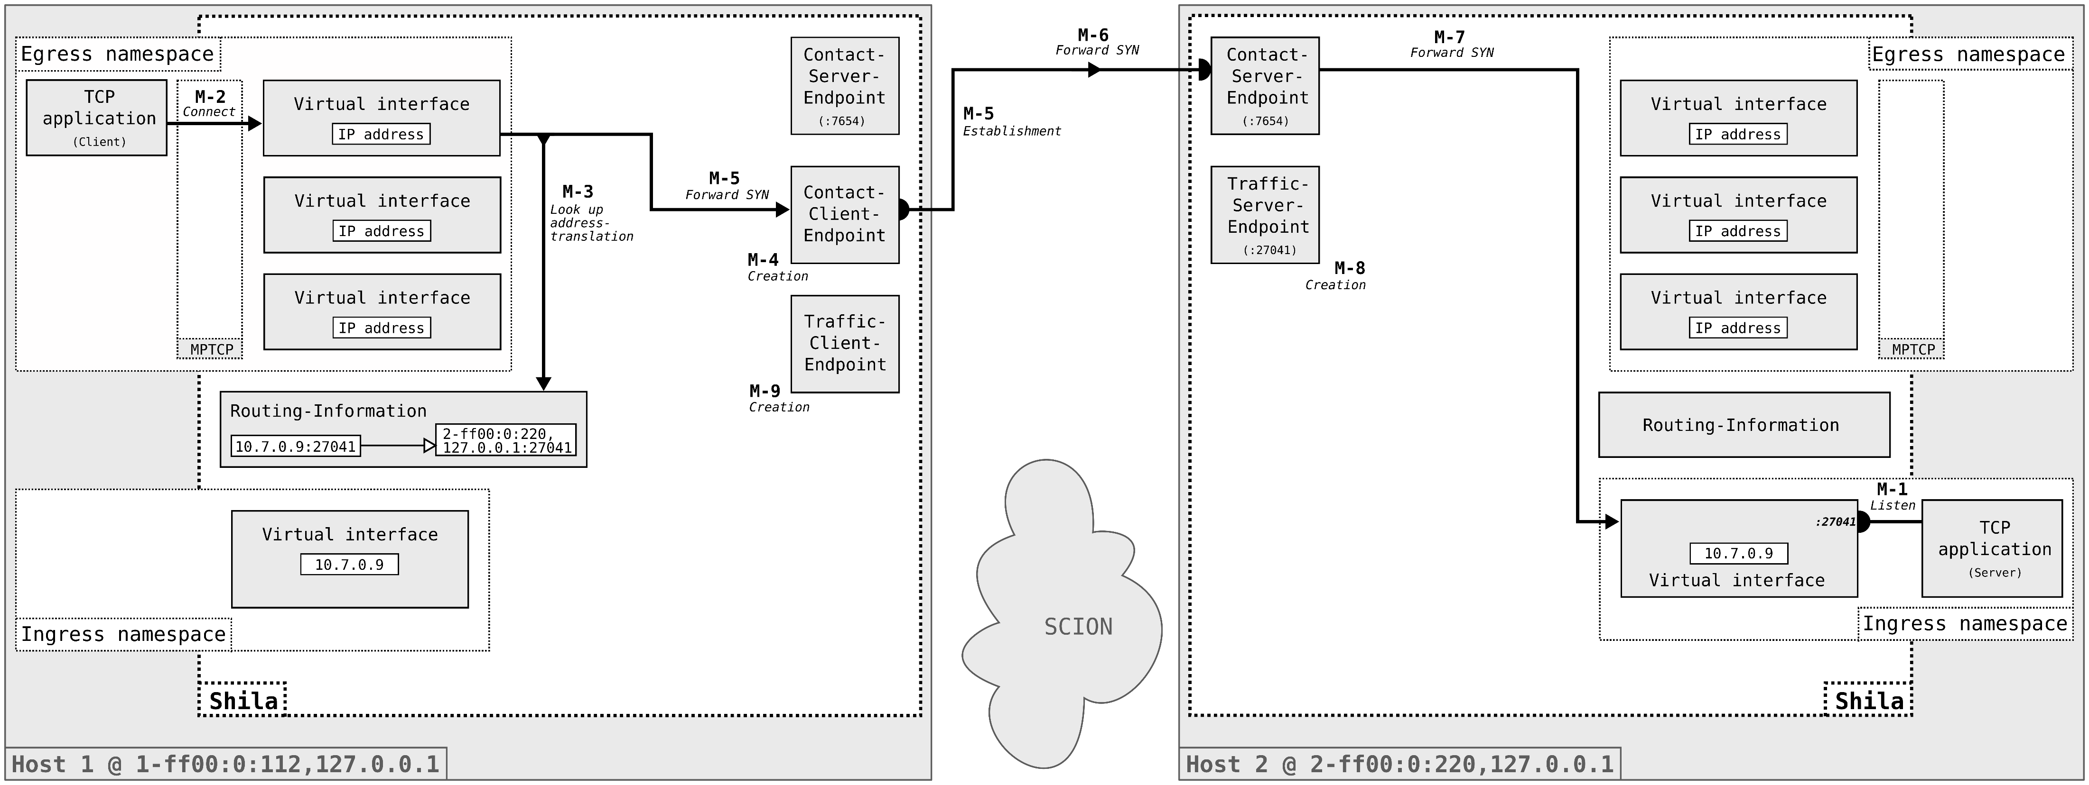
Projektanalyse – Folie 2
Functionality of Shila
Main-Flow Establishment

Slide 28

Projektanalyse – Folie 2
Functionality of Shila
Main-Flow Establishment

Slide 29
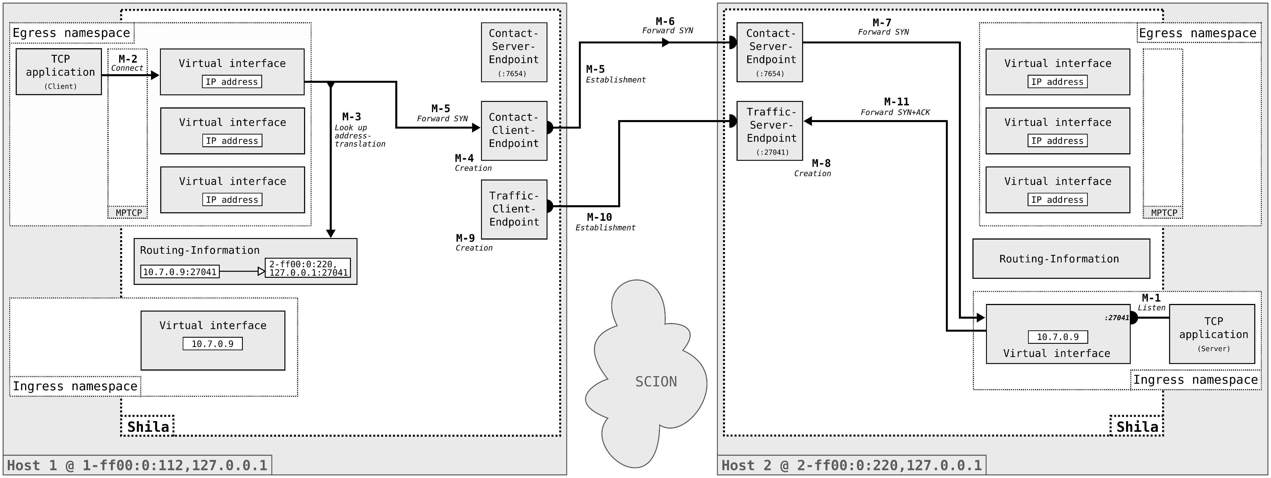
Projektanalyse – Folie 2
Functionality of Shila
Main-Flow Establishment

Slide 30

Projektanalyse – Folie 2
Functionality of Shila
Main-Flow Establishment

Slide 31
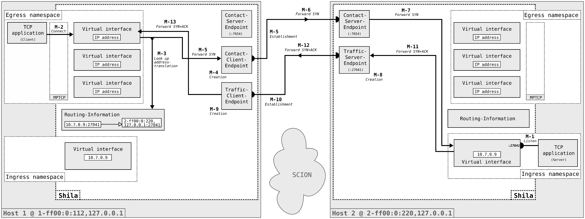
Projektanalyse – Folie 2
Functionality of Shila
Main-Flow Establishment

Slide 32
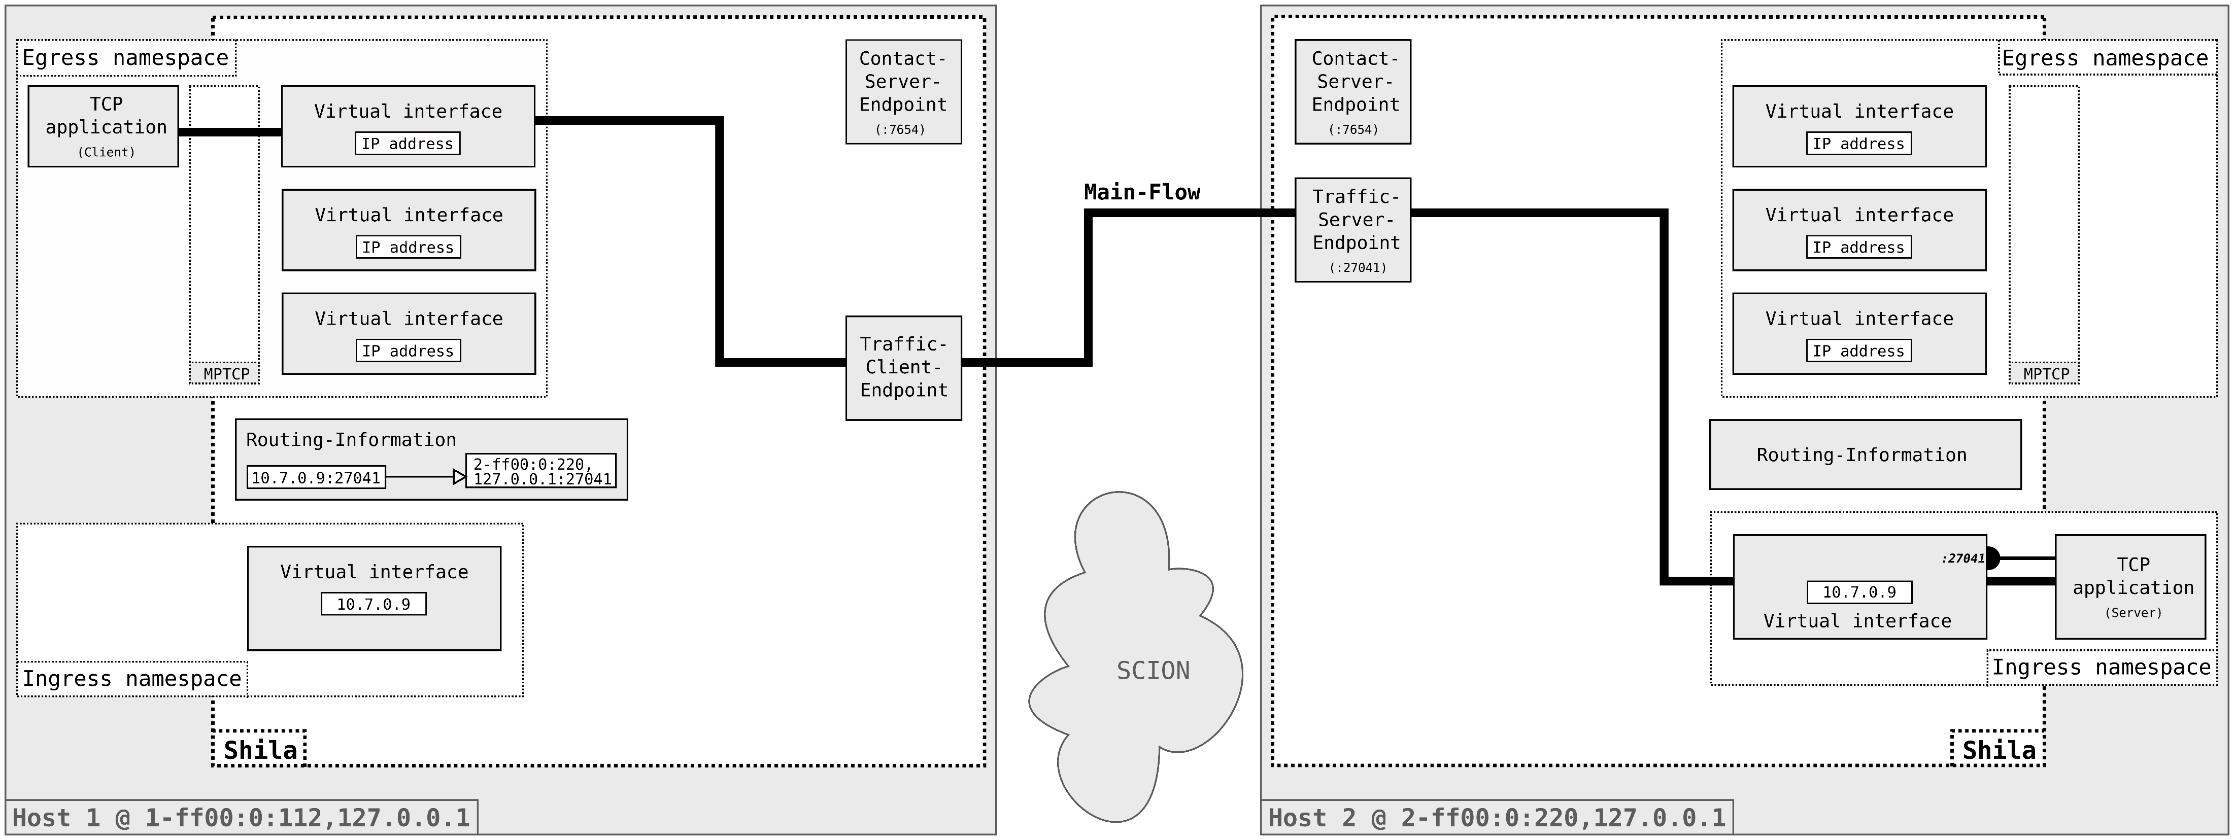
Projektanalyse – Folie 2
Functionality of Shila
Main-Flow Establishment

Slide 33

Projektanalyse – Folie 2
Functionality of Shila
Sub-Flow Establishment

Slide 34
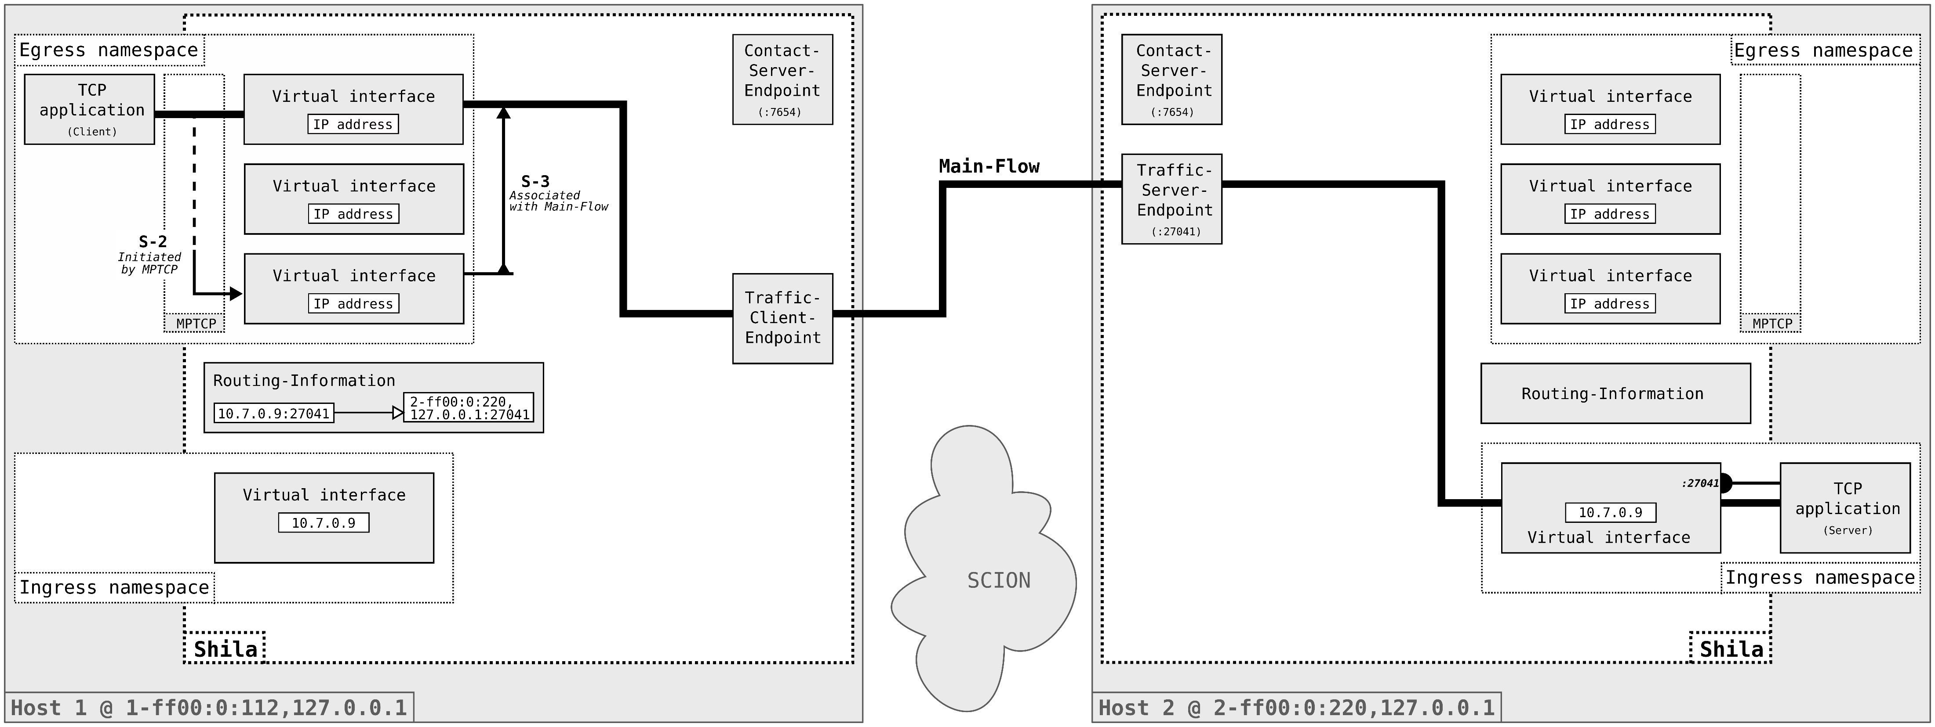
Projektanalyse – Folie 2
Functionality of Shila
Sub-Flow Establishment

Slide 35
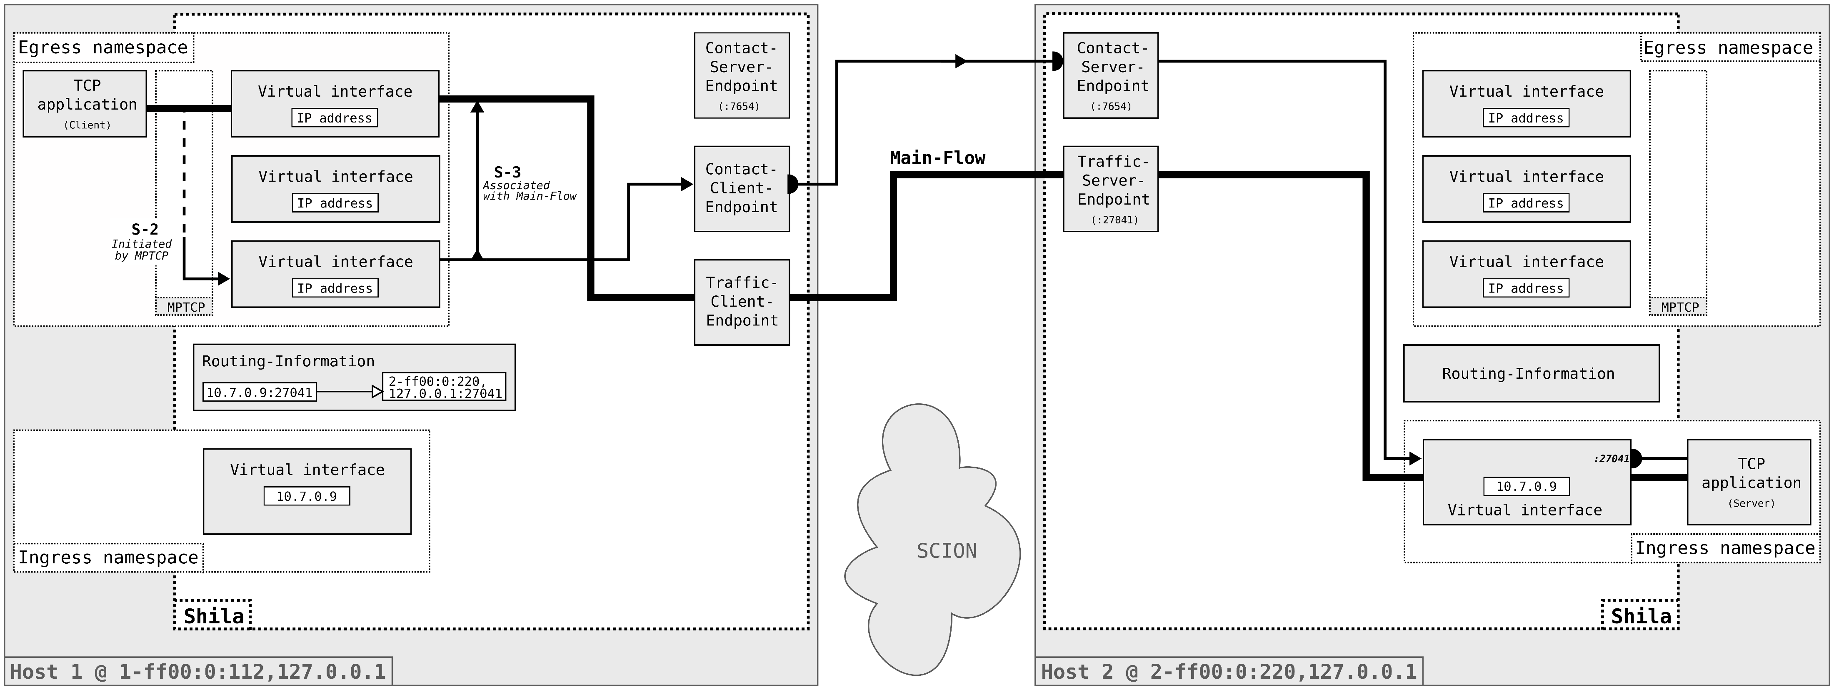
Projektanalyse – Folie 2
Functionality of Shila
Sub-Flow Establishment

Slide 36
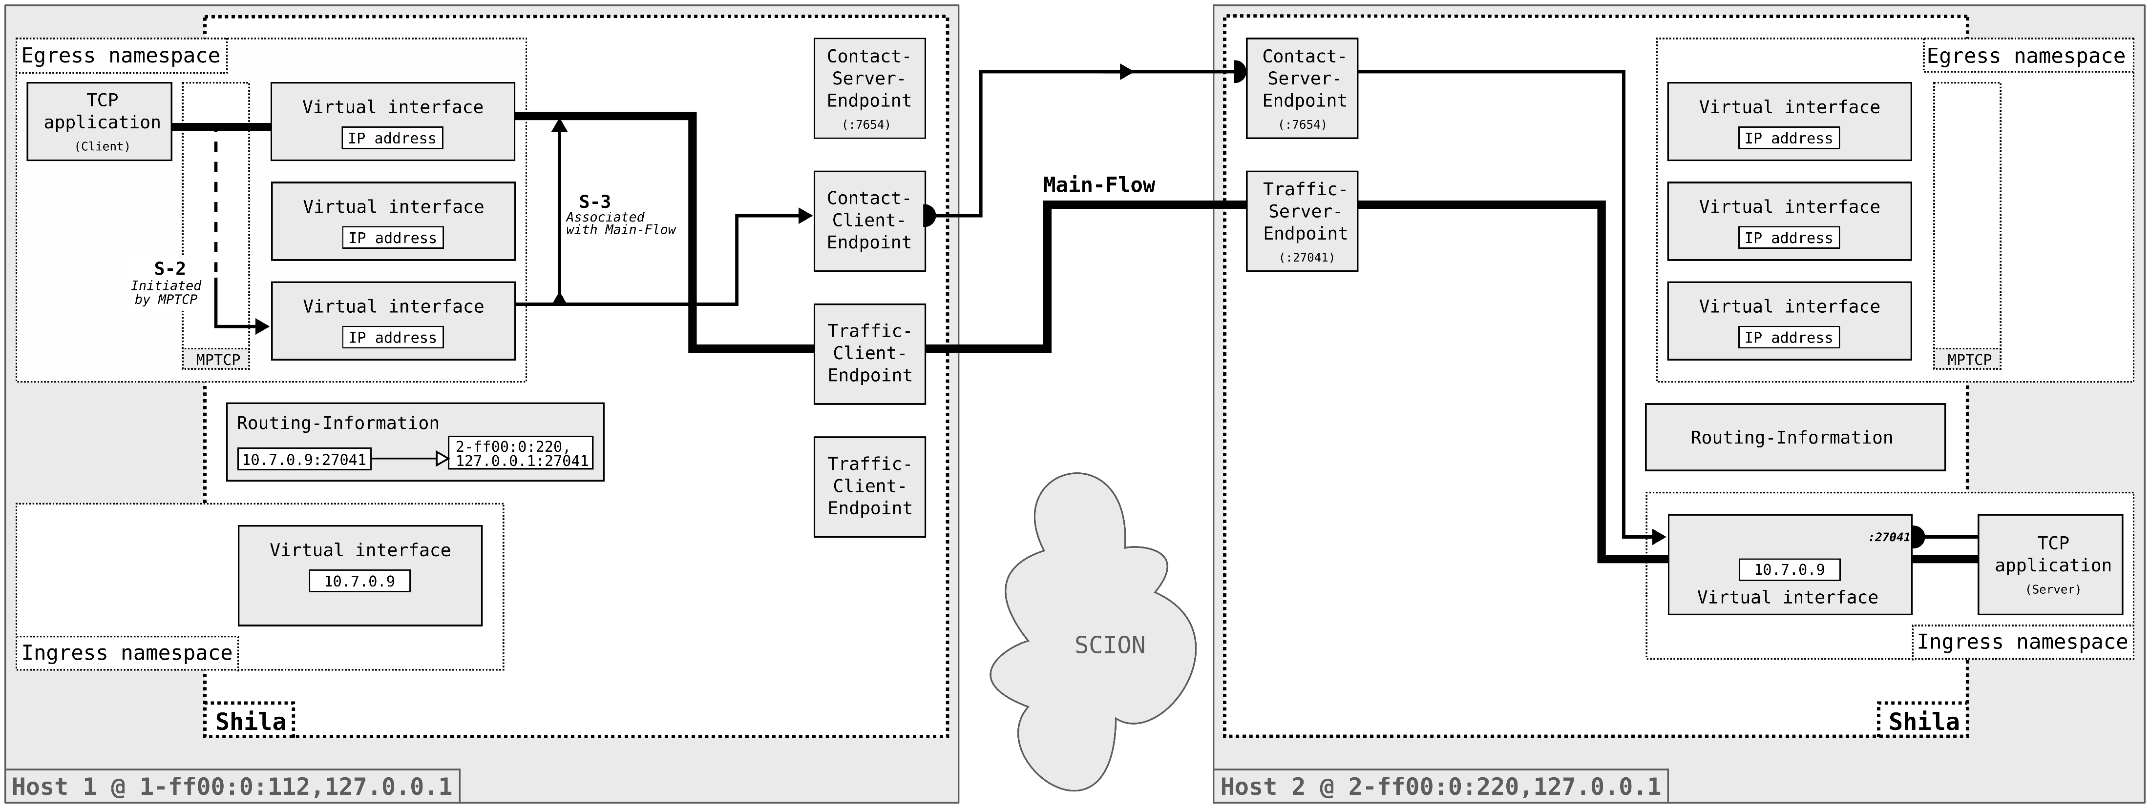
Projektanalyse – Folie 2
Functionality of Shila
Sub-Flow Establishment

Slide 37
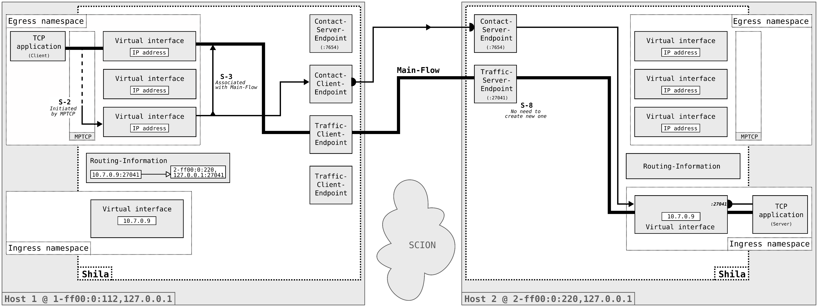
Projektanalyse – Folie 2
Functionality of Shila
Sub-Flow Establishment

Slide 38

Projektanalyse – Folie 2
Functionality of Shila
Sub-Flow Establishment

Slide 39

Projektanalyse – Folie 2
Functionality of Shila
Sub-Flow Establishment

Slide 40
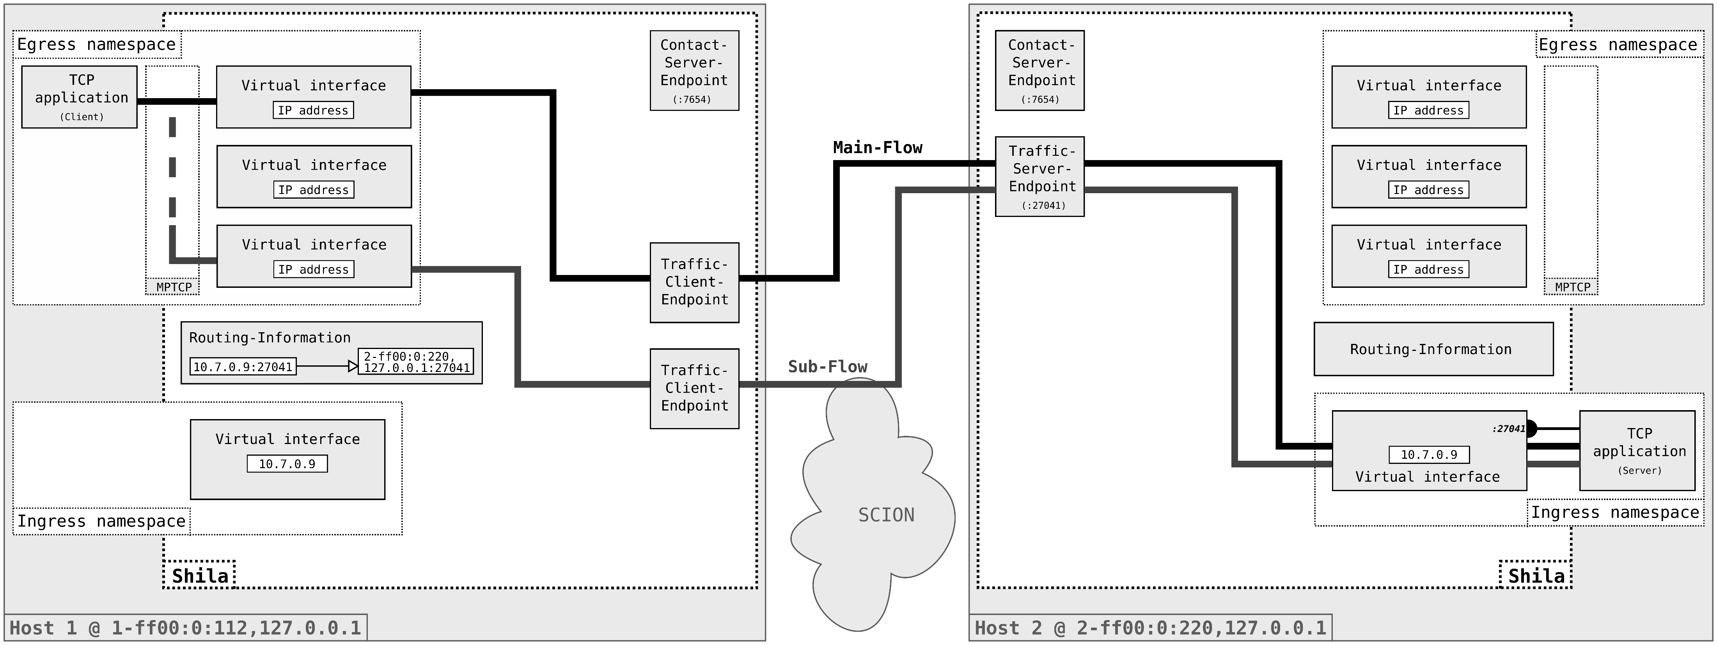
Projektanalyse – Folie 2
Functionality of Shila
Data Exchange

Slide 41
Projektanalyse – Folie 2
On the menu
Introduction
Functionality of Shila
Performance evaluation
Future work
Notes:
Introduction: What ingredients? What? Why?
Shila: How? (Setup – Connection establishment – Data transfer)
Performance: How good?
Future work: What is next?

Slide 42
Projektanalyse – Folie 2
On the menu
Introduction
Functionality of Shila
Performance evaluation
Future work
Notes:
Introduction: What ingredients? What? Why?
Shila: How? (Setup – Connection establishment – Data transfer)
Performance: How good?
Future work: What is next?

Slide 43
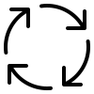

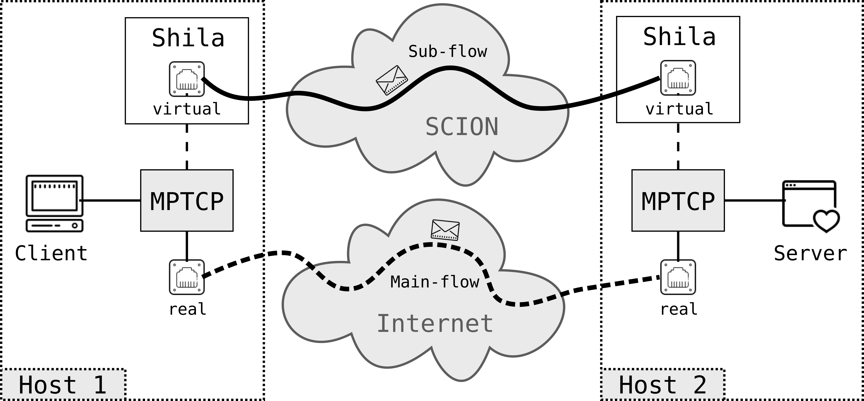

Projektanalyse – Folie 2
Future work
What is next?
Conduction of revision cycles
Improve implementation of Shila
Further testing
Side-by-side approach
Main-flow over conventional Internet
Sub-flow(s) over SCION
Addition of flexibility
Provide mapping betwenn TCP and SCION destination address upon connection establishment
Remove need for namespaces
Notes:
Conduction of revision cycles: For the implementation of Shila, still prototype character, further testing and revision cycles too increase its quality and performance.
Addition of flexibility: In current state, user has to supply mapping upon start-up of Shila, not really practicable, goal to find / implement ways to make this more flexible, one possible approach could for example be to provide the necessary option via IP socket options. Would then require a wrapper around the default TCP API…
Side-by-side approach: Does not interfere with a users known working environment, facilitates the development of SCION, user can just support from the use of it.

Slide 44
Thank you.

Slide 45

Shila as a girls’ name means ”blind”. Shila is a varian form of Sheila (Irish, Gaelic): version of Sile.
STARTS/ENDS WITH Sh-, -la

